Slide 1
EXPLORATORY DATA ANALYSIS : TASK 2
Poromendro Nath Burman
9/16/20

Slide 2
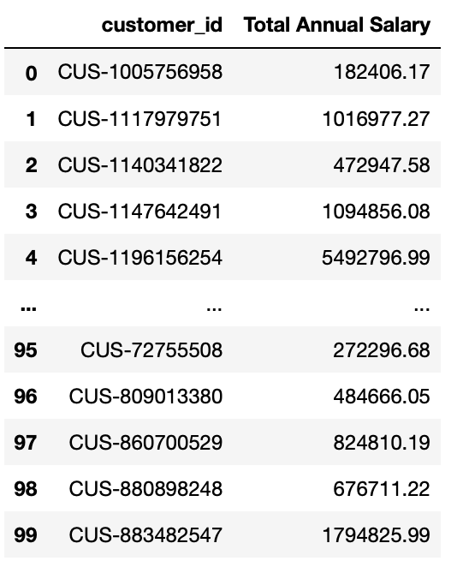
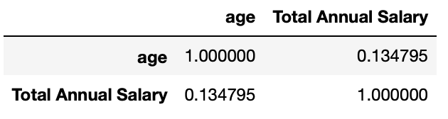
DATA ANALYSIS RESULTS
Annual salary
2. Correlation

Slide 3
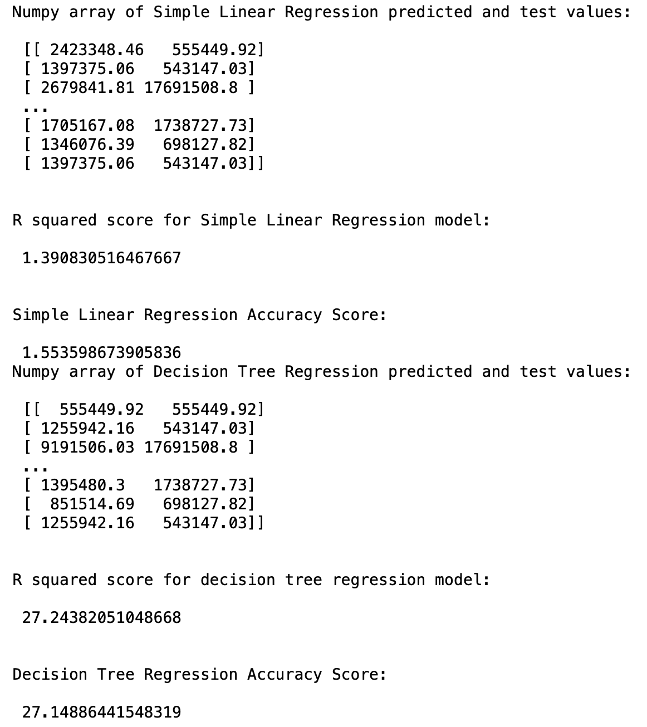
DATA ANALYSIS RESULTS
4. Regression models
6. Conclusion : There isn’t a strong correlation between the age and the total annual salary to use simple regression of decision tree models for prediction

